Slide 1

NATIONAL INSTITUTE OF TECHNOLOGY - ANDHRA PRADESH DEPARTMENT OF COMPUTER SCIENCE AND ENGINEERING
ANOMALY DETECTION
IN
LIVE SURVEILLANCE VIDEOS
Under the Guidance of
Dr. K Hima Bindu
Asst.Prof.
Dept. of CSE, NIT-AP
Jaya Shankar, Naveen and Deva
B.Tech. (CSE) 7Th Semester
Roll No. 29, 25 and 23

Slide 2
CONTENTS
Problem Statement
Model
Literature Review
Proposed Work Plan
References

Slide 3
PROBLEM STATEMENT
There are many crimes occurring and there are around 250 million cameras in use today capturing them.
Tiring process to manually detect and rise an alarm.
Till date, specific anomaly detectors are available but not an overall detector.
Ambiguity between normal and anomalous activity.
Deep Learning helps in detecting such anomalous activities.

Slide 4
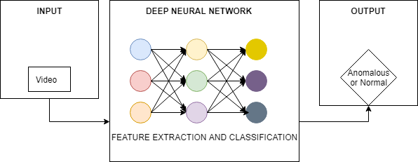
DEEP LEARNING MODEL

Slide 5
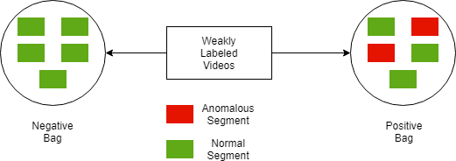
MULTIPLE INSTANCE LEARNING
Multiple Instance Learning
Weakly labeled training data.
Difference between traditional supervised learning and Multiple instance learning.

Slide 6
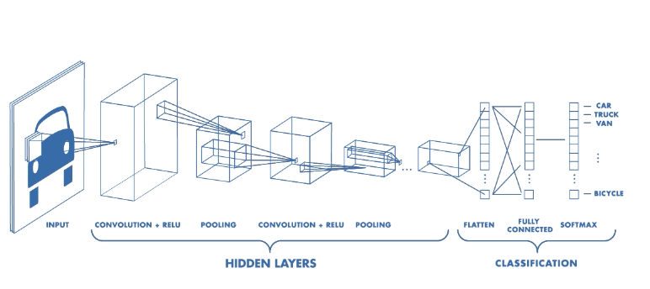
CONVOLUTIONAL NEURAL NETWORK
Neural Network with Convolutional Layers.
Convolutional layer has filter that does convolution operation.
Filter is just a window of matrix that slides through the input features.

Slide 7
FEATURE EXTRACTION
Convolutional 3D Network
Convolution Neural Network
Pooling Layer

Slide 8
FEATURE EXTRACTION
Convolutional 3D Network
3D Convolution is better than 2D Convolution to model temporal information.
2D CONV : performed only spatially, lose temporal information.
3D CONV : performed spatio-temporally, preserve temporal information.
Same phenomena is applicable for pooling.
Generic, Compact, Simple and Efficient.

Slide 9
FEATURE EXTRACTION
Tube Convolutional Neural Network (TCNN)
Video is divided into equal length clips
Clips are fed to tube proposal network.
Proposals are linked according to their scores.
Spatio-temporal action detection is performed using these proposals.
Tube of Interest pooling is applied to the proposal to generate fixed length feature vectors.

Slide 10
DEEP NEURAL NETWORK
Input: Features.
Output: Score.
3 Layer fully connected network.
The first FC layer has 512 units followed by 32 units and at last 1 unit FC layer.
Dropout regularization between the FC layers.
Activation function to map score to either 0 or 1.

Slide 11
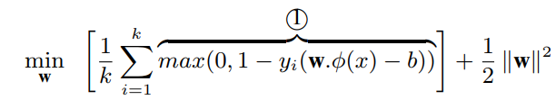
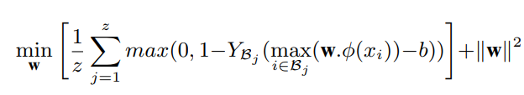
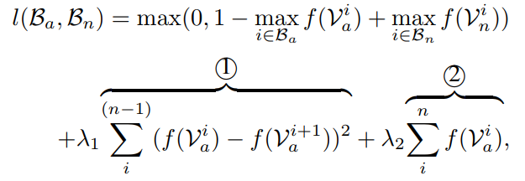
SCORING AND LOSS FUNCTION

Slide 12
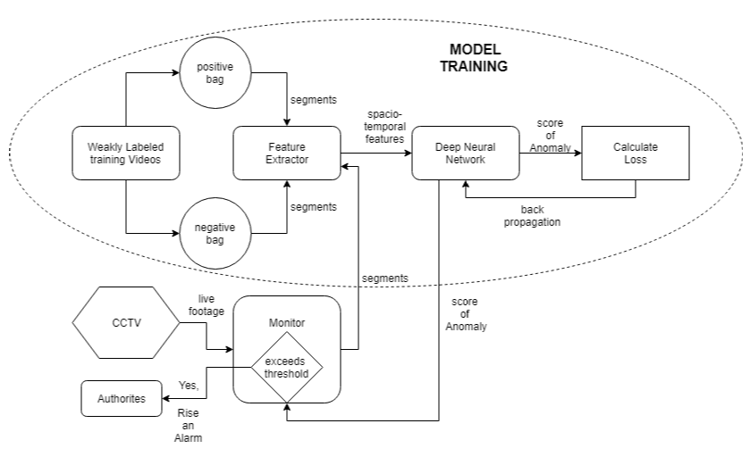
OVERALL MODEL

Slide 13
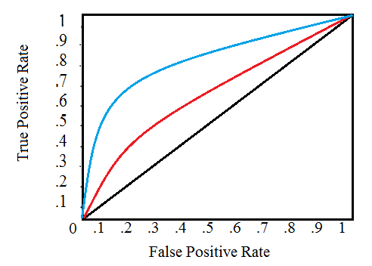
EVALUATION METRIC
ROC and AUC to obtain the right threshold.

Slide 14
STATE OF THE ART METHODS
METHOD | AUC
Binary SVM Classifier | 50
Dictionary Based Approach | 65
Deep Neural Network w/o constraints | 74
Deep Neural Network w constraints | 75
TCNN feature extraction method provides better accuracy than the C3D Feature Extraction method.

Slide 15
PROPOSED WORKPLAN
Challenging Data set. (done)
Environment Set up. (done)
Feature Extraction.
Training Model.
Classifying a video into three classes
Criminal or violent activity
Potentially suspicious
Safe
Testing
“Above to be completed in this semester”

Slide 16
PROPOSED WORKPLAN
Challenges to be addressed:
Feature Extraction from a live running CCTV footage.
Less time delay between Anomaly occurrence and alarm.
Reducing the false alarms due to genuine normal activity.
Class Imbalance problem.
Extending the model to work even in night vision and in presence of external disturbances.
“Above to be done in next semester”

Slide 17
Implementation details
Keras 1.1.0
Theano 1.0.2
Tensor Flow 1.1
Python 3
Ubuntu 18.10
Nvidia Geforce GTX 1080 GPU.

Slide 18
REFERENCES
1. Sultani, Waqas and Chen, “Real-world Anomaly Detection in Surveillance Videos”, Center for Research in Computer Vision (CRCV), University of Central Florida (UCF), 2018.
2. R. Hou, C. Chen, and M. Shah. Tube convolutional neural network (t-cnn) for action detection in videos. In ICCV, 2017.
3. http://crcv.ucf.edu/cchen/
4. https://dzone.com/articles/video-analysis-to-detect-suspicious-activity-based

